Slide 1
LWR Trivia
A Game Show with Lasting Impact

Slide 2
In the Beginning
What’s in the name?
Global
From the Ground Up
Faith in Action
Poverty
200
200
200
200
200
200
400
400
400
400
400
400
600
600
600
600
600
600
800
800
800
800
800
800
1000
1000
1000
1000
1000
1000
CLICK FOR FINAL JEOPARDY

Slide 3
IN THE BEGINNING: 200
Steve Martin,
Diane Sawyer,
and Bob Marley were born, the second World War ended, and LWR was formed in this year.

Slide 4
IN THE BEGINNING: 400
The 20th century war that left approximately 1/5 of the world’s Lutherans homeless.

Slide 5
IN THE BEGINNING: 600
These are the flags of the countries where LWR first worked OUTSIDE of Europe. Your answer is the name of ONE of them.

Slide 6
IN THE BEGINNING: 800
LWR works with these people and organizations to be closer to the communities we serve around the world.
Hint: You might work with one of these on a school project.

Slide 7
IN THE BEGINNING: 1000
After learning of the bad conditions in Europe after WW II U.S. Lutherans with German and Scandinavian backgrounds began LWR because of their care for these people.

Slide 8
WHAT’S IN THE NAME?: 200
LWR is an acronym that stands for
______ ______ ______.

Slide 9
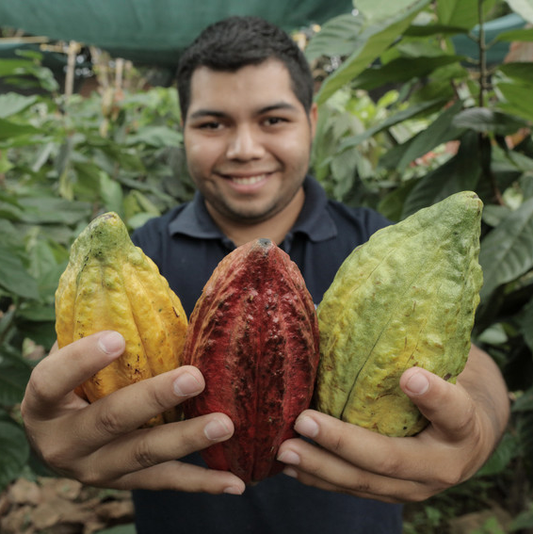
WHAT’S IN THE NAME?: 400
This is the word that means “walking with people” and not
“doing for” or the piano part of a choral arrangement.

Slide 10
WHAT’S IN THE NAME?: 600
According to LWR’s mission statement, God’s love extends to this many people.

Slide 11
WHAT’S IN THE NAME?: 800
God’s promise for the world, mentioned in LWR’s motto, is this.
Hint: Does it ever end?

Slide 12
WHAT’S IN THE NAME?: 1000
Gratitude, Calling, Accompaniment, Stewardship, and Innovation are all these for LWR and Lutherans.
Hint: this word is something
of great worth.

Slide 13
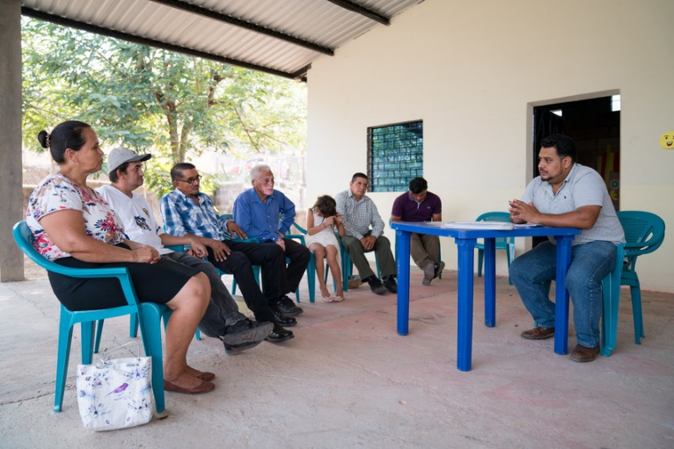
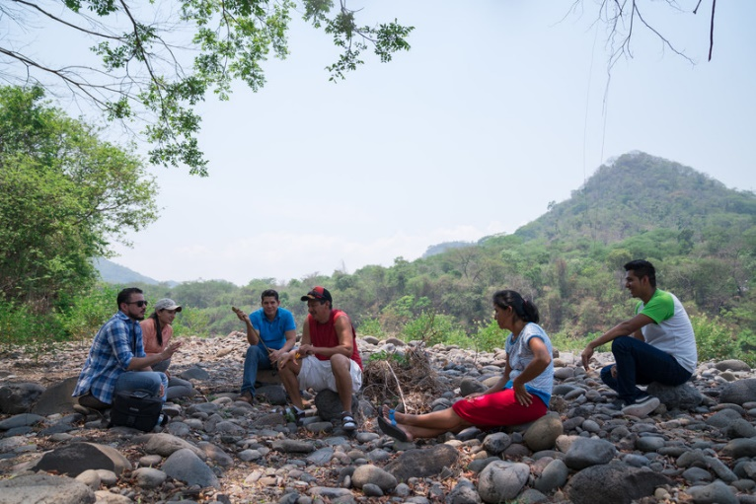
GLOBAL: 200
These are community leaders in Morazán, El Salvador
The river there poses a threat for this natural disaster
that can happen during their rainy season.

Slide 14
GLOBAL: 400
Only 1% of this essential natural resource is readily available for humans to use?

Slide 15
GLOBAL: 600
Women account for nearly half of the world’s smallholder farmers. They own less than what percentage of cultivated land worldwide?

Slide 16
GLOBAL: 800
This is a type of strong storm that occurs between May and September in the region of South and Southeast Asia.

Slide 17
GLOBAL: 1000
DOUBLE
DIFFERENCE
MAKER!
Please Place Your Wager!

Slide 18
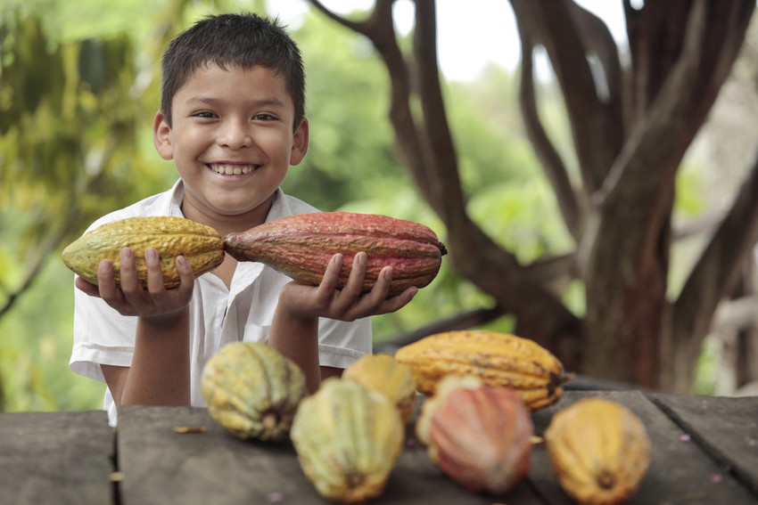
FROM THE GROUND UP: 200
This crop helps with reforestation in Central America, and helps farmers make more money from their produce. It is eventually made
into a tasty treat!

Slide 19
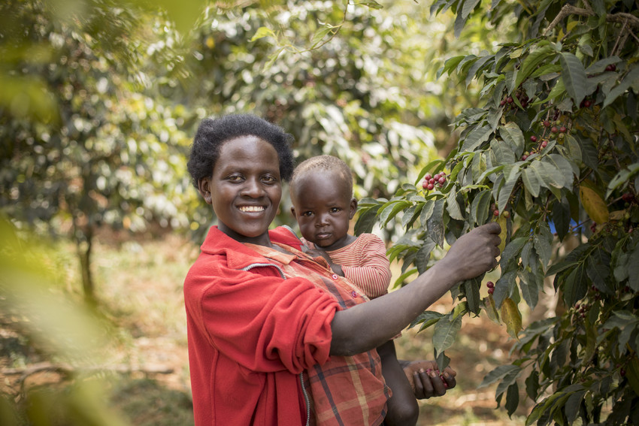
FROM THE GROUND UP: 400
Farmers in Uganda
have been able to increase their incomes
by learning new techniques and improving quality of this crop.
HINT: The beans from the crop are fermented, dried, roasted, and ground before they make their way to a mug during breakfast. Many churches have a whole hour devoted to this crop on Sundays!

Slide 20
FROM THE GROUND UP: 600
Small holder farmers don’t always get a fair price for their crop but this LWR project provides a strong, up-front price for their beans, and allows farmers to share in the profits from the sale of their crop.

Slide 21
FROM THE GROUND UP: 800
This small herd animal with curved horns can provide milk, meat, and increased income to many women farmers and
their families in Burkina Faso.

Slide 22
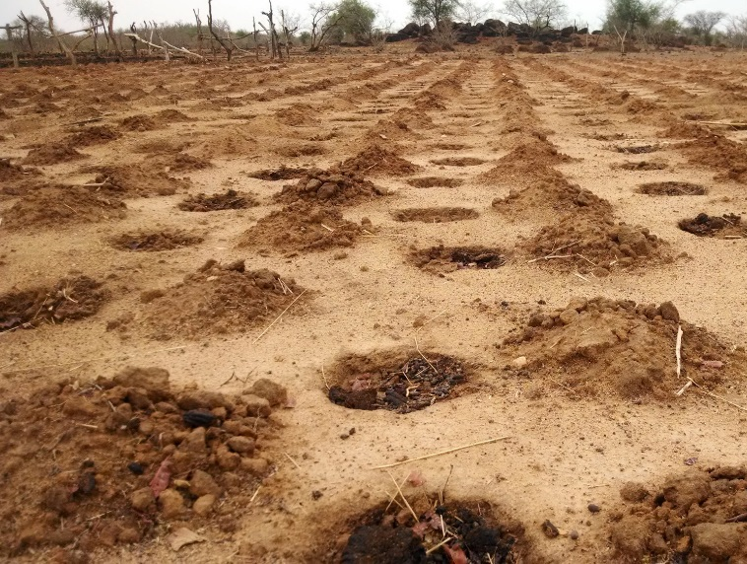
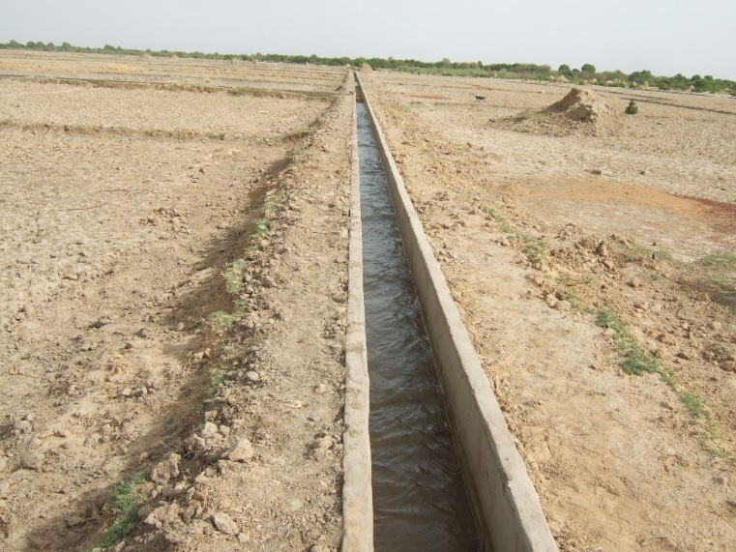
FROM THE GROUND UP: 1000
This farming practice is
necessary in areas where it is
very dry for most of the year.

Slide 23
FAITH IN ACTION: 200
LWR sent 198,245 School Kits around the world in 2019. Each Kit contains 5 pencils and 5 pens. This is the number of writing utensils that Lutherans distributed in 2019.

Slide 24
FAITH IN ACTION: 400
These gifts of warmth,
made by Lutherans in the
U.S., have made their way to the Mother of Mercy Women’s House (Peru), which welcomes youth, single mothers, orphans and the elderly who want
to learn a trade.

Slide 25
FAITH IN ACTION: 600
Personal hygiene is important in times of disaster to help prevent spread of disease and protect a person’s God given dignity.
These are 2 items that Lutherans share when they assemble an
LWR Personal Care Kit.

Slide 26
FAITH IN ACTION: 800
A prenatal healthcare worker in Peru might distribute kits with clothes, blankets, towels, and soap
to a mother for this important person
in her life.

Slide 27
FAITH IN ACTION: 1000
LWR and our partners can teach a person to
stitch, repair, and make clothing or other textiles, so they can earn an income and break out of poverty, with these two items donated through a kit from U.S. Lutherans.

Slide 28
POVERTY: 200
DOUBLE
DIFFERENCE
MAKER!
Please Place Your Wager!

Slide 29
POVERTY: 400
Think that all people who need water don’t have any nearby? Think again! An open water container without proper sanitation and maintenance might cause this problem for families in poverty.

Slide 30
POVERTY: 600
Roughly 70% of people in developing countries work in this industry. You could say they know much more about where their food comes from than you and I do!

Slide 31
POVERTY: 800
Since 2011, over 5.7 million Syrians have registered as refugees, primarily in Iraq, Lebanon, Egypt, Turkey, and Jordan. Which of these countries hosts the largest number of Syrian refugees?

Slide 32
POVERTY: 1000
Small holder farmers around the world feel harsh effects of changing climates and decreasing produce. These are 2 things that farmers can change to make their crops a little tougher, or their land a little better.

Slide 33
What is 1945?

Slide 34
What is World War II?

Slide 35
Acceptable Answers include:
What is
India
Korea
Palestine
Bangladesh
Hong Kong
Israel

Slide 36
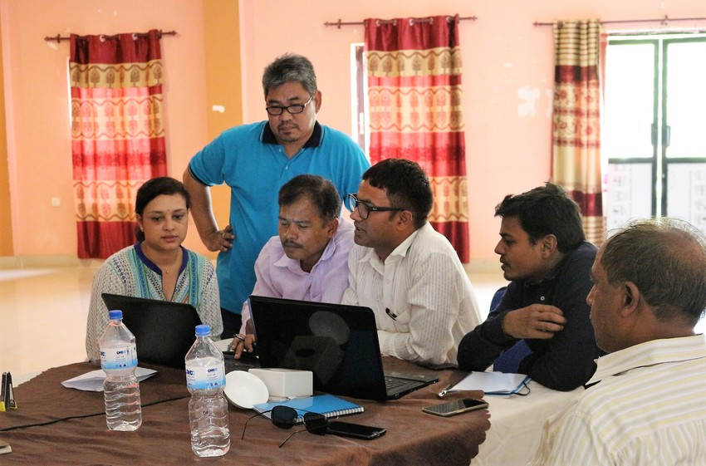
What are partners?
Partners from the Trans-Boundary Resilience project in India and Nepal work together at a monitoring and evaluation workshop.

Slide 37
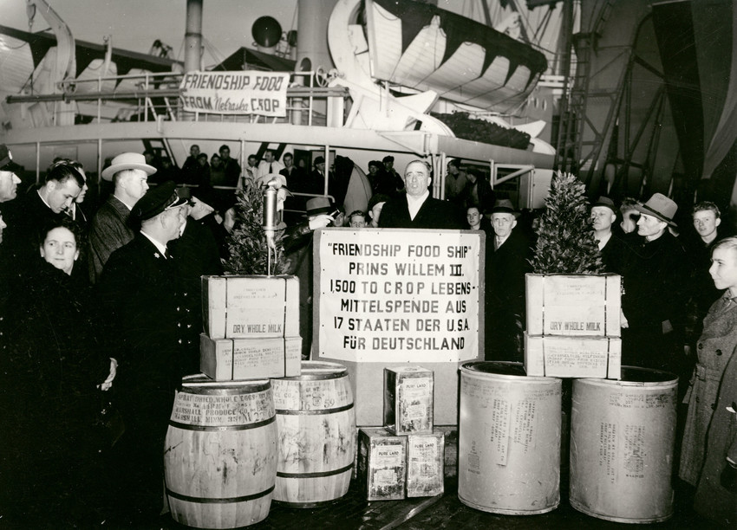
What are friends, family, relatives or other Lutherans?

Slide 39
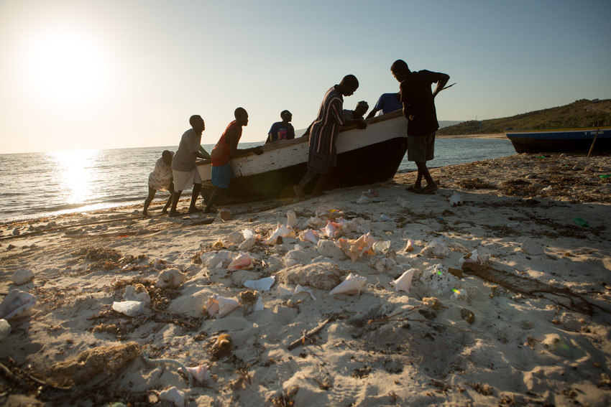
What is
Accompaniment?

Slide 40
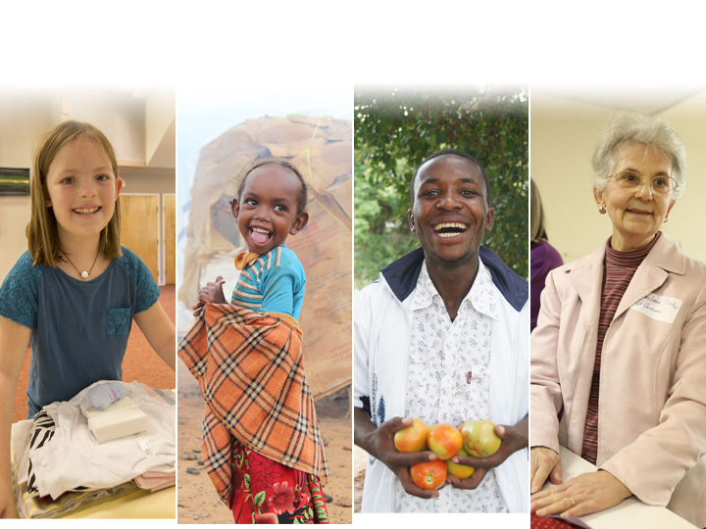
What is ALL people.
v

Slide 41
What is LASTING?

Slide 42
What are values.

Slide 43
What is a flash flood?

Slide 44
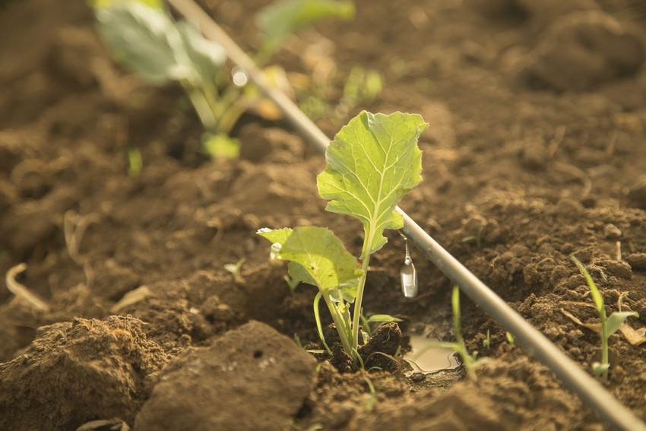
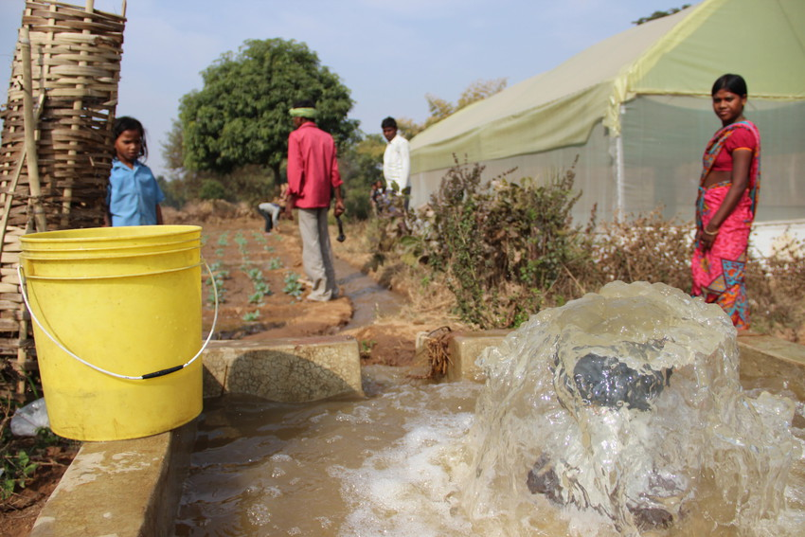
What is Water?
Did you know that wells are not always the answer for improving water access? Different communities need different solutions – from cisterns to drip irrigation and everything in between!

Slide 45
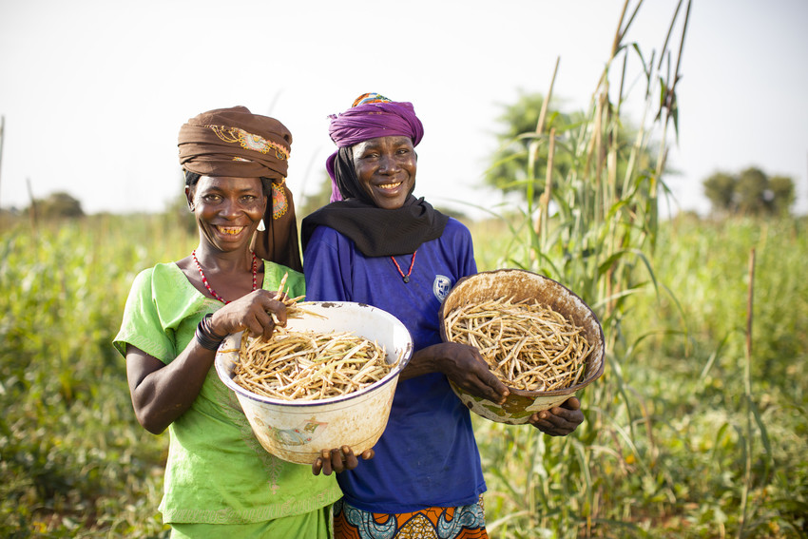
20%
Did you know that 70% of Africa’s food is produced by women farmers?

Slide 46
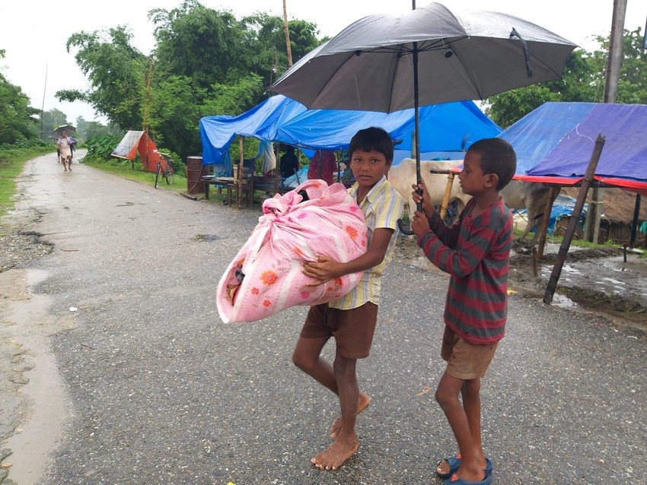
What is a monsoon?
11,839: Number of households displaced in eastern Nepal from a storm in July of 2019.
LWR has been working with communities in the Koshi and Kamala river basins along the India-Nepal border to strengthen their resilience to monsoon-related flooding.

Slide 47

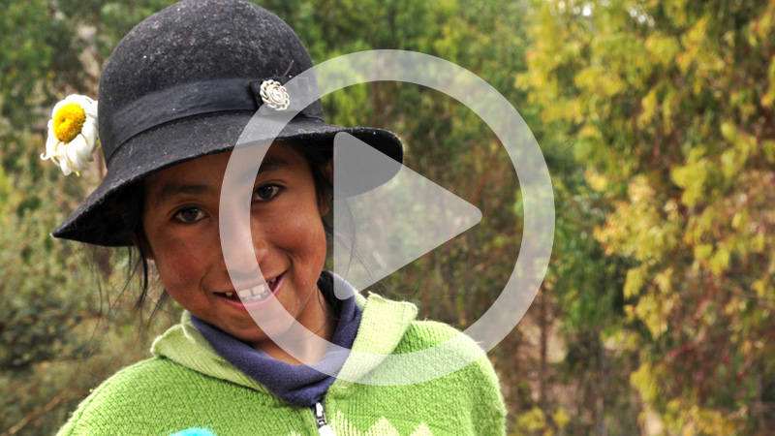
People have left Peru because of political problems
and extreme weather conditions. This is a reason
why people like Daisy’s family might stay.

Slide 48
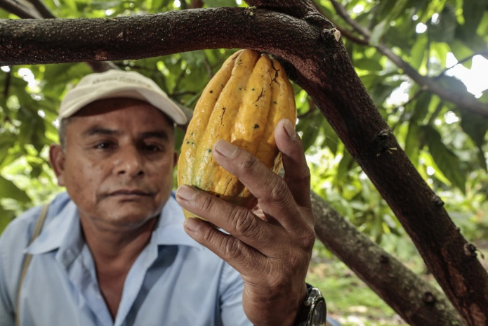
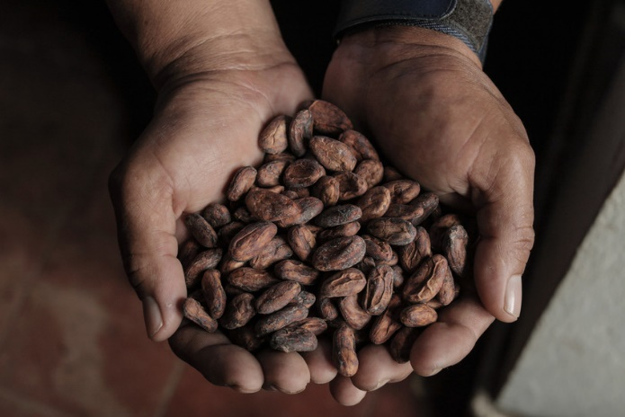
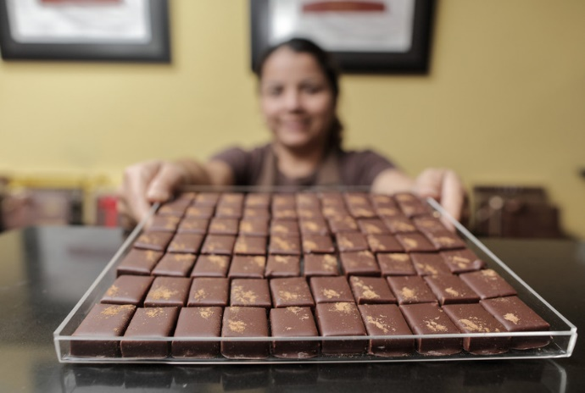
What is Cacao
or Cocoa?

Slide 49
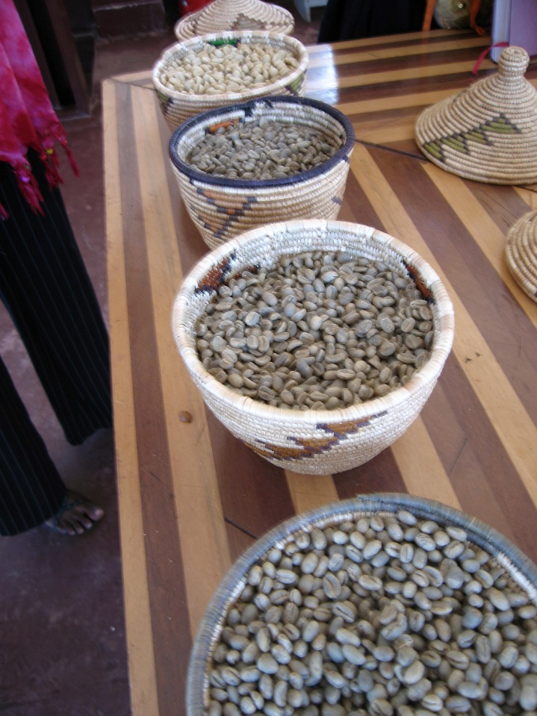
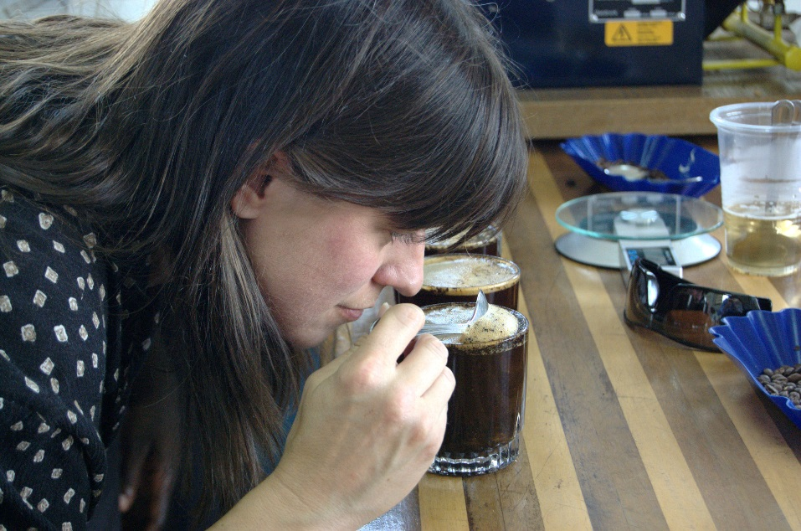
What is Coffee?

Slide 50
What is LWR Farmers Market Coffee?

Slide 51
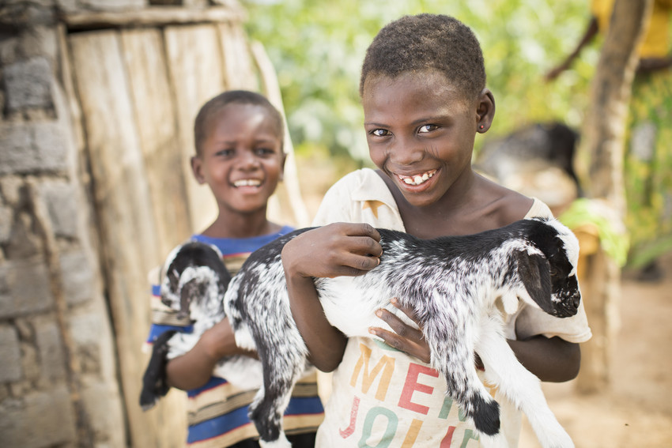
What is a goat?

Slide 52
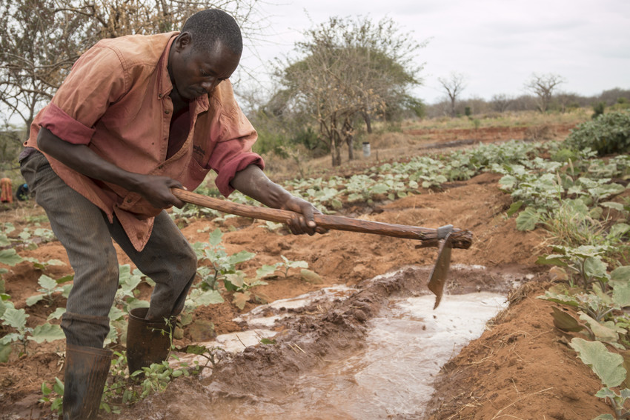
What is irrigation?

Slide 53
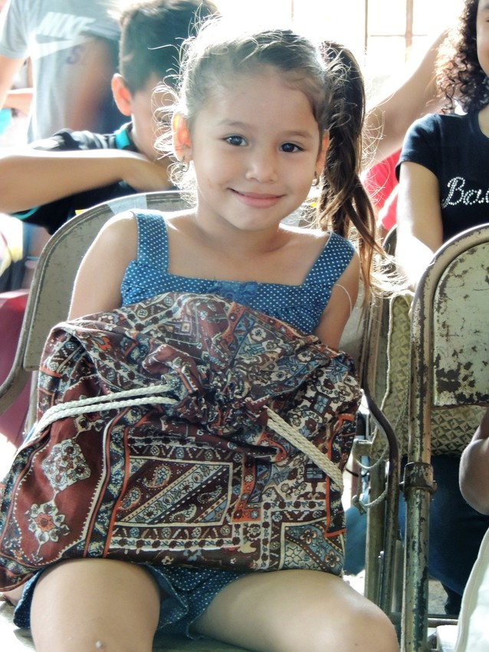
What is 1,982,450
writing utensils? That’s a lot!

Slide 54
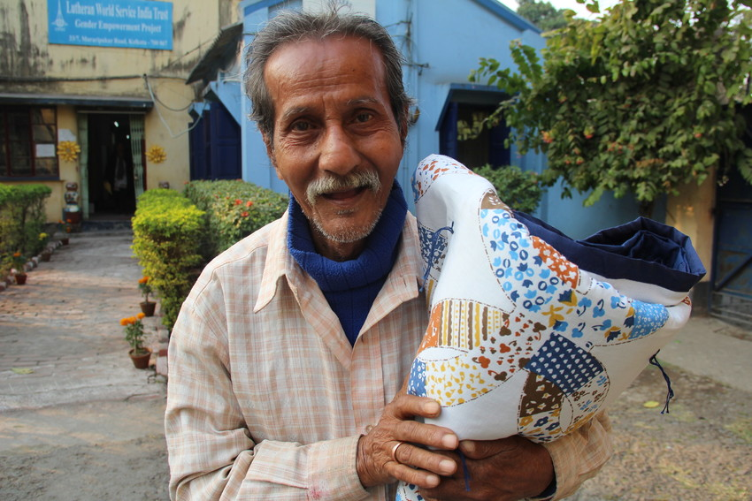
What are Quilts,
or Mission Quilts?

Slide 55
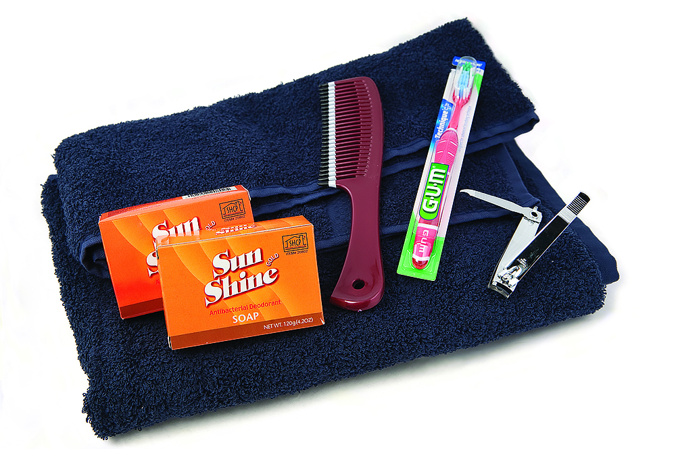
What are a towel,
a bar of soap,
a toothbrush,
a comb, or
nail clippers?
Did you know? These kits are distributed to
survivors of natural disasters overseas as well as places
like orphanages and nursing homes in a variety of countries.

Slide 56
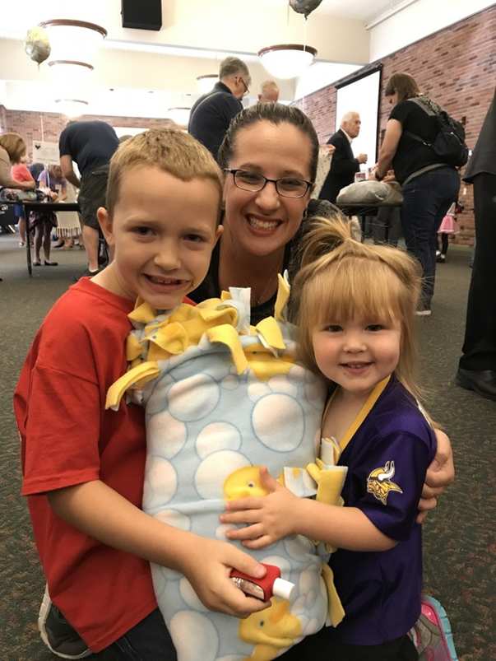
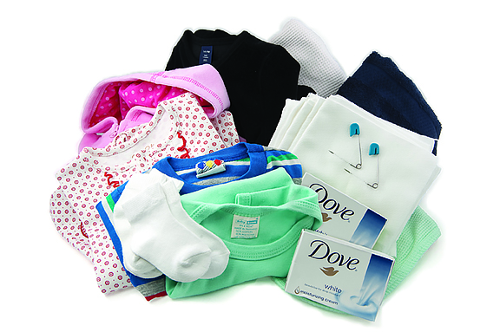
What is
her baby?

Slide 57
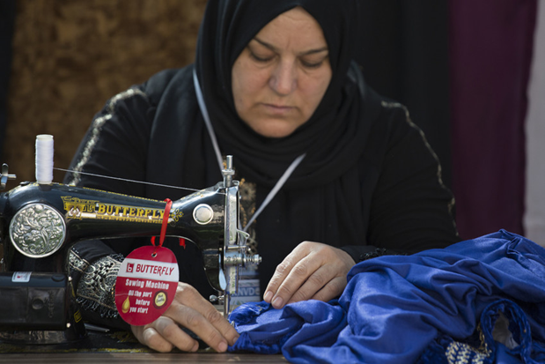
What is fabric and thread in our Fabric Kits?

Slide 58
Food Insecurity means not having enough food to eat, AND not having money or means to get enough. The phrase food insecurity is often referred to using this common term.

Slide 59
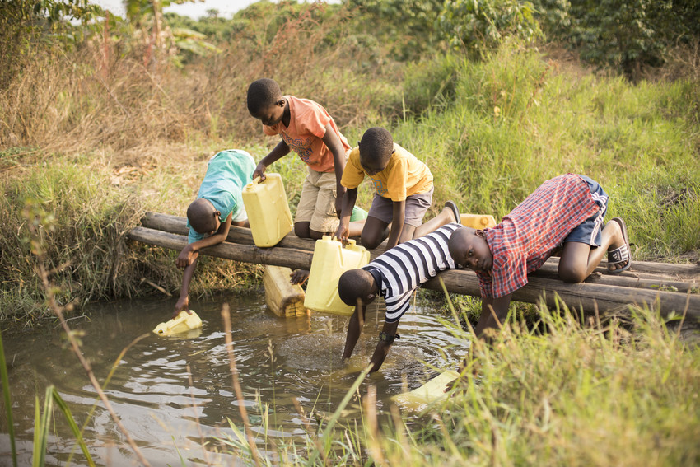
What is disease or illness?
Did you know: A closed catchment container for a spring
is a huge first step in making water safer for communities?
Sometimes the water from rivers and lakes is contaminated.

Slide 60
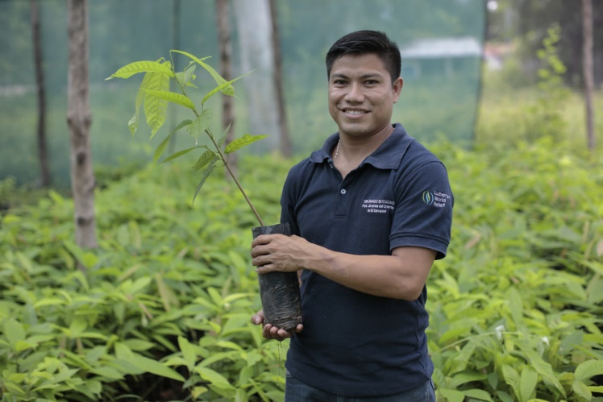
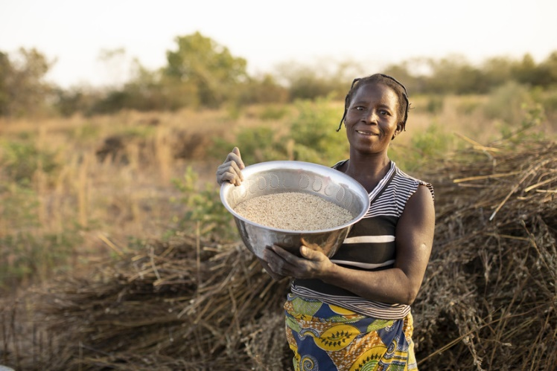
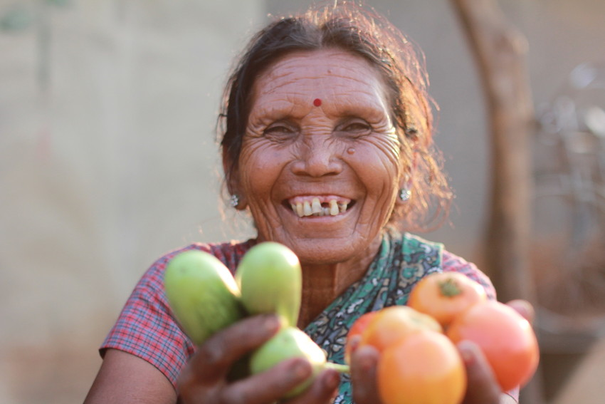
What is Agriculture or Farming?

Slide 61
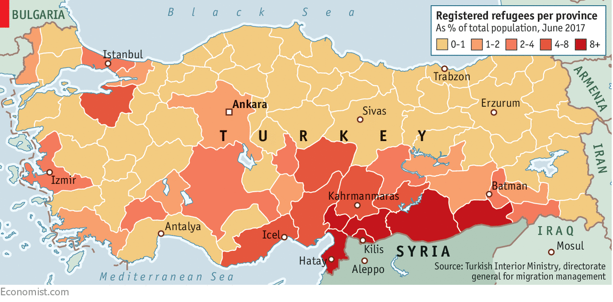
What is Turkey?
As of November 2019, 3,744,926 Syrian refugees are residing in Turkey. LWR has been working with refugees in the region since the start of the conflict.

Slide 62
What is growing different things (diversification), planting tougher seeds (climate smart seeds), and/or changing the planting, irrigation, and harvesting times and methods?

Slide 63
What is family/ancestral heritage
or connection, no money to buy
other land or a new house,
or knowledge of the land/crop
has been passed down so that’s how they know how to make a living?
Think about it: If you had a family but no money,
would you pick up everything and move far away?

Slide 64
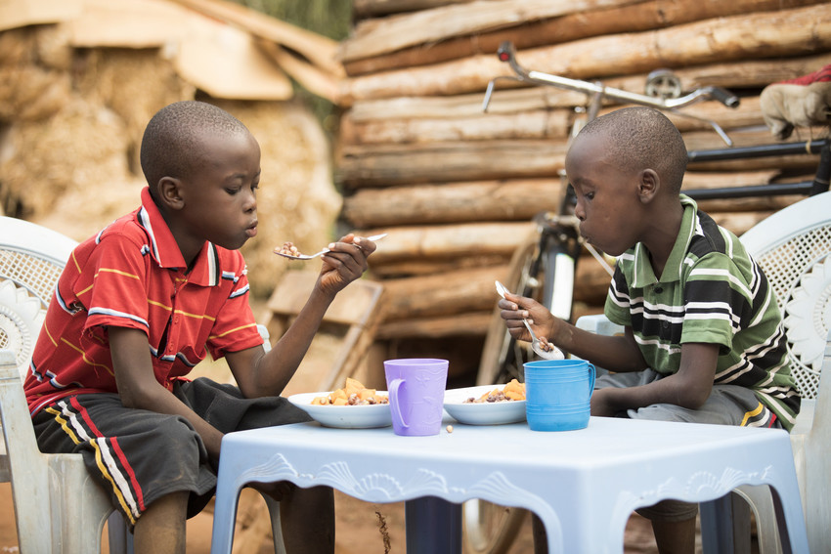
What is Hunger?
This is a category under food security that means people often go without food, and continuously are unsure of
the source of their food.
Did you know: LWR’s work with small farmers is helping with food security? When people have the means to produce, they can make more money, grow more food to eat, and feed their families.

Slide 65
Place your wager.
Your team will now decide how many points to wager. The team may wager as many as 200 more points than what they currently have.
If the team’s answer is correct, the points wagered are added to their final score. If the team’s answer is incorrect, the wagered
points are deducted from their final score.
Notes:
65

Slide 66
After you click the above link, teams will have exactly 1 minute to record their answer.

Slide 67
Name 5 of the 25 countries where LWR has programs today.

Slide 68
Please reveal your answers, then click HERE.

Slide 69
Any combination of the following:
LATIN AMERICA:
Colombia, Dominica, El Salvador, Guatemala, Haiti, Honduras, Nicaragua, Peru
AFRICA:
Democratic Republic of Congo, Kenya, South Sudan,
Tanzania, Uganda, Burkina Faso, Mali, Mauritania, Niger
ASIA & THE MIDDLE EAST:
India, Indonesia, Nepal, Philippines, Iraq, Lebanon, Syria, Yemen

Slide 70
lwr.org
800.597.5972
Lutheran World Relief is a ministry of U.S. Lutherans,
serving communities living in poverty overseas.

